Slide 1
Project #5
Passenger and Driver Safety
Group: Miguel, Colin, Fabian, Justin
Notes:
Each member Introduces themselves
Simple Change detection ⇒ first goal
Try to get local system working first before streaming.
Only changed events transmit
Next, how many events are there? Try to find the different events you are interested in.

Slide 2
Motivation and Vision
Currently, bus camera systems are unable to benefit from cloud based computing due to the cost of transferring continuous video streams over cellular networks.
To mitigate this cost, we propose an intelligent event detection system composed of both a cloud and local component such that only events of interest are sent to the cloud for training.

Slide 3
Vision Continued
First, the event detection algorithm will be trained manually on a cloud based web application.
The algorithm will then be deployed locally on a camera system constructed to integrate with the cloud application.
The local system will send only flagged events to the cloud.
Monitors using the cloud application can then classify the events to refine the algorithm.
The refined algorithm is then redeployed to the local systems.

Slide 4
Key Application Features (Cloud System)
Device registration
Neural network training
Searchable media database
Secure web connection
User interface
Media upload
Media classification
Alarm configuration
API endpoint

Slide 5
Key Application Features (Local System)
Neural network for pattern recognition
Upload media
Download neural network
Alarm signal
Interface with streaming camera system
Failsafe against false positives
Video streaming for emergencies

Slide 6
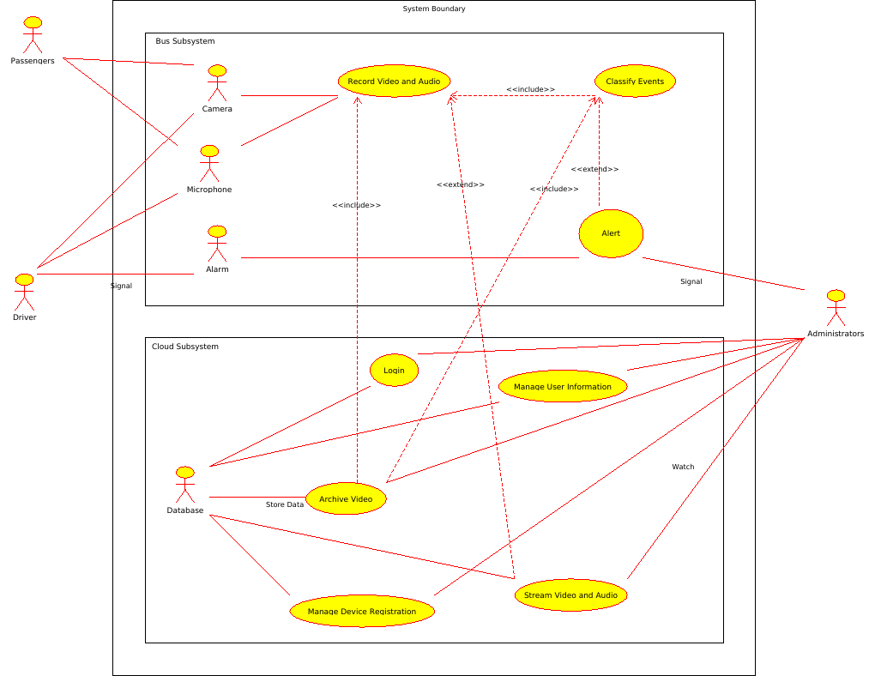
Overview of the Project

Slide 7
Risk Analysis
Computing power of device used isn’t enough.
Gathering of training/example data.
Design and Implementation of a Camera System.
Picking data segments to send over a network to the server.
Legal liability of false positive notifications.
Notes:
Presenter: Fabian

Slide 8
Tools to be Used
GitHub
Google Drive
Python
Tensorflow
Django
OpenCV
Ubuntu Linux Cloud Server

Slide 9
Project Plan
Sprint 1: 1/7/2019 - 1/16/2019
Project Plan
Requirements
Tool Chain Setup
Project Scope Capture
Sprint 2: 1/16/2019 - 1/23/2019
Cloud hosted server setup and configuration
Camera system research / design / deployment
Initial data collection

Slide 10
Project Plan
Sprint 3: 1/23/2019 - 2/11/2019
Web UI and basic functionality
Continued data collection
Sprint 4: 2/11/2019- 2/25/2019
Label / identify events in data for training
Start manual training of the algorithm
Add monitoring statistics to Web UI

Slide 11
Project Plan
Sprint 5: 2/25/2019 - 3/11/2019
Continue collecting data and refining the algorithm
Start testing the algorithm against a subset of labeled data
Web UI Improvements
Sprint 6: 3/11/2019 - 3/25/2019
Continue collecting data and refining the algorithm
Web UI Improvements
Start testing on unlabeled data and review post flagging

Slide 12
Project Plan
Sprint 7: 3/25/2019 - 4/9/2019
Continued Testing and debugging
Dry Run - full autonomous detection
Sprint 8: 4/9/2019 - 4/24/2019
Continued Testing and debugging
Final Competition

Slide 13
Next Sprint
Research, acquire, and setup our local hardware.
Setup and configure the initial cloud server application.
Setup user and device registration.
Setup database in the cloud.
Start acquiring training data.

